Slide 1
Introduction
Reference Models

Slide 2
Reference Models
The OSI Reference Model
The TCP/IP Reference Model
A Comparison of OSI and TCP/IP
A Critique of the OSI Model and Protocols
A Critique of the TCP/IP Reference Model

Slide 3
Reference Models (Contd.)
A layer is created where a different abstraction is needed
Each layer should perform a well-defined function
The function of each layer should be chosen with an eye toward defining internationally standardized protocols
The layer boundary should be chosen to minimize the information flow across interfaces
The number of layers should be large enough that distinct functions need not be thrown together out of necessity and small enough that the architecture does not become unweildy

Slide 4
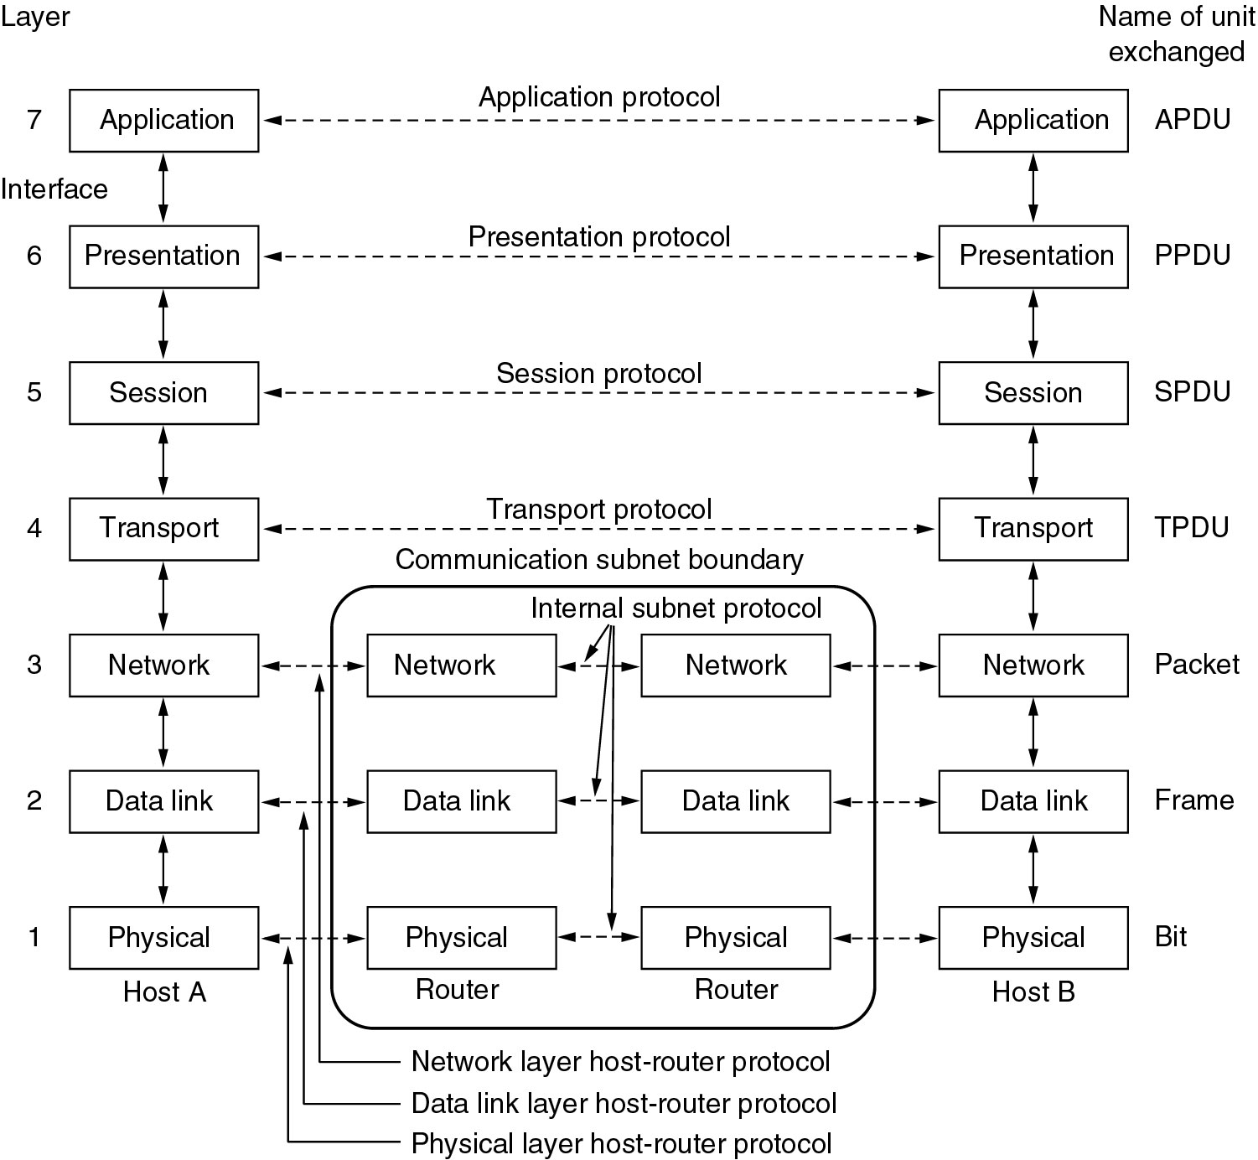
Reference Models
The OSI reference model.

Slide 5
Physical Layer (questions)
How many volts should be used to represent 1?
How many nanoseconds does a bit last?
Transmission may proceed in one direction or multiple directions.
How will the initial connection be established?
How many pins does the network connector have?

Slide 6
DataLink Layer
Raw transmission facility in a line that appears free of undetected errors to the network layer.
Data frames → acknowledgement frame

Slide 7
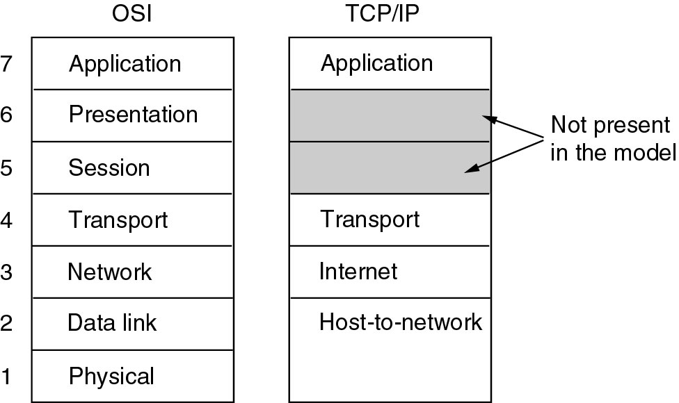
Reference Models (2)
The TCP/IP reference model.

Slide 8
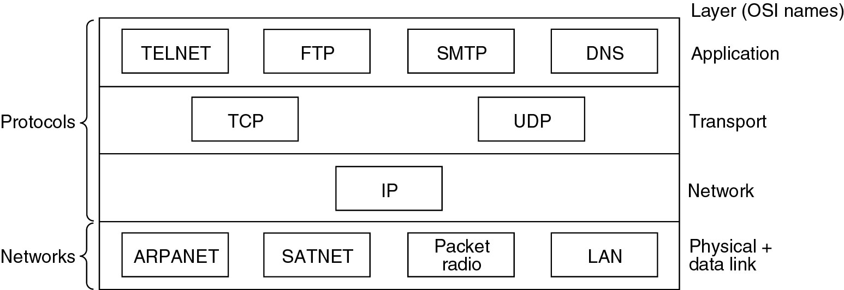
Reference Models (3)
Protocols and networks in the TCP/IP model initially.

Slide 9
IP Layer
Packet Switching
Transport Layer
TCP – Flow control
UDP – Fast Delivery

Slide 10
Comparing OSI and TCP/IP Models
Concepts central to the OSI model
Services
Interfaces
Protocols
TCP – retrofit/
OSI – DataLink Layer (point-to-point)

Slide 11
Differences between OSI and TCP/IP model
OSI model supports connectionless and connection-oriented communication in the network layer but only connection-oriented communication in the transport layer
TCP/IP model has one mode in the network layer (connectionless) but supports both modes in the transport layer

Slide 12
A Critique of the OSI Model and Protocols
Why OSI did not take over the world
Bad timing
Bad technology
Bad implementations
Bad politics

Slide 13
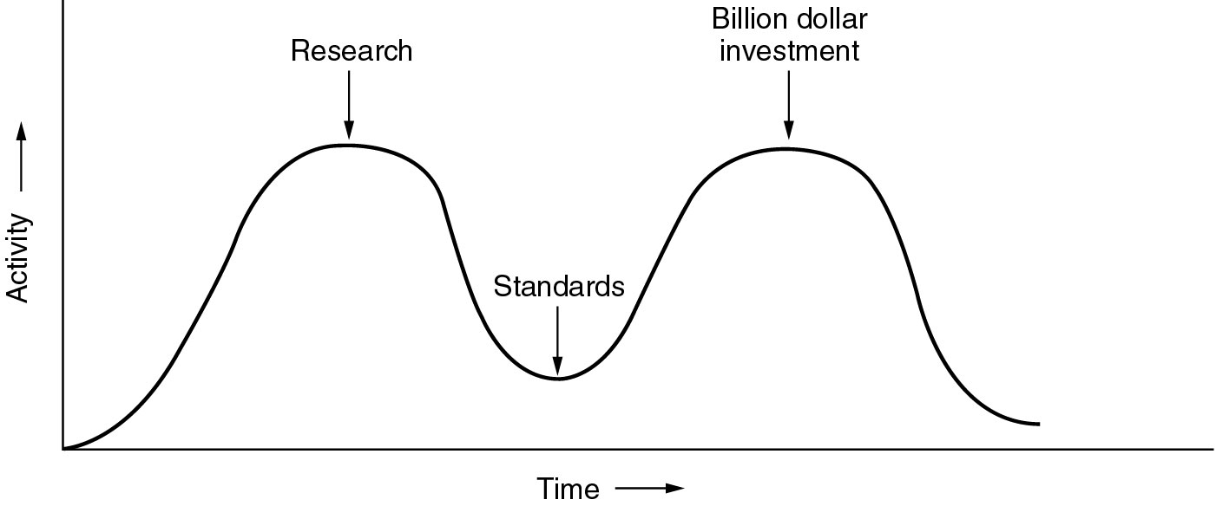
Bad Timing
The apocalypse of the two elephants. (Standard came much later)

Slide 14
Bad Implementation
Initial version were huge, unwieldy and slow.
Bad Politics
TCP/IP part of Unix, OSI – governement pushed

Slide 15
A Critique of the TCP/IP Reference Model
Problems:
Service, interface, and protocol not distinguished
Not a general model
Host-to-network “layer” not really a layer
No mention of physical and data link layers
Minor protocols deeply entrenched, hard to replace

Slide 16
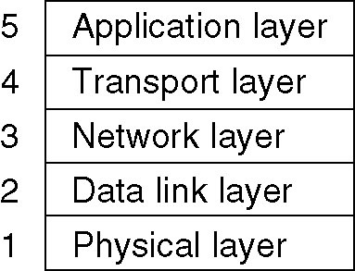
Hybrid Model
The hybrid reference model to be used in this book.

Slide 17
Example Networks
The Internet
Connection-Oriented Networks:
X.25, Frame Relay, and ATM
Ethernet
Wireless LANs: 802:11

Slide 18
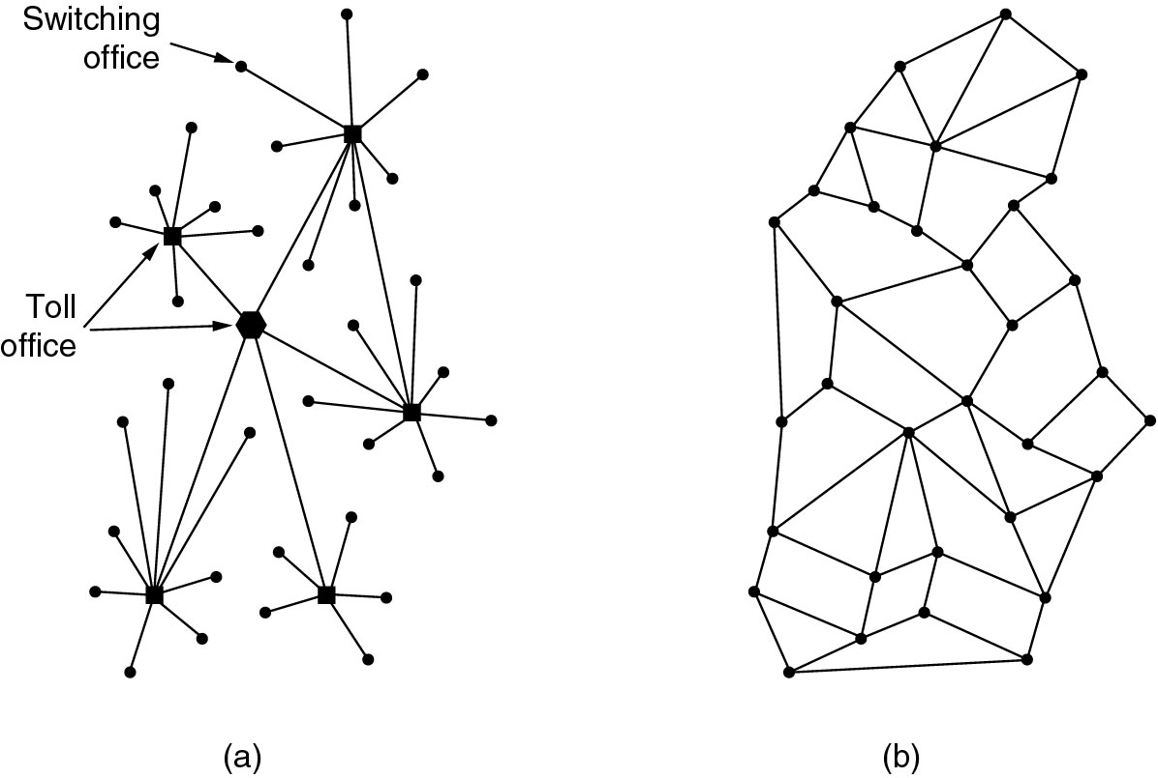
The ARPANET
(a) Structure of the telephone system.
(b) Baran’s proposed distributed switching system.

Slide 19
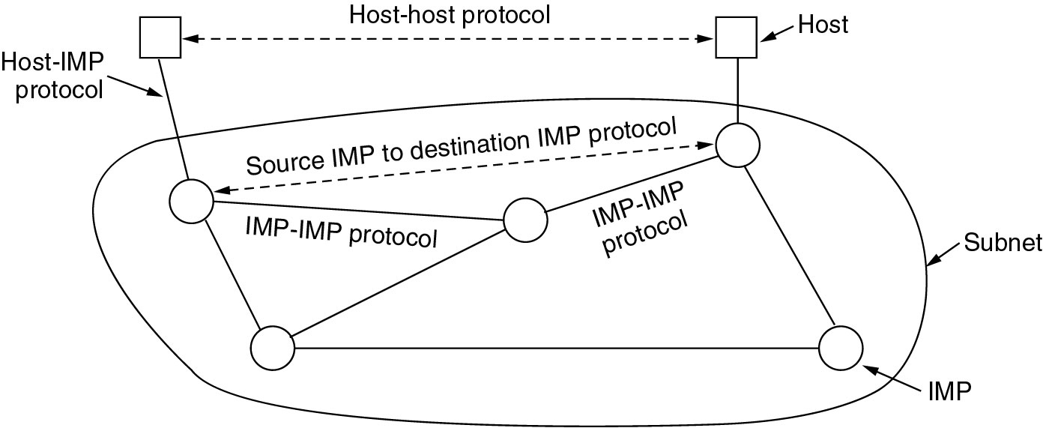
The ARPANET (2)
The original ARPANET design.

Slide 20
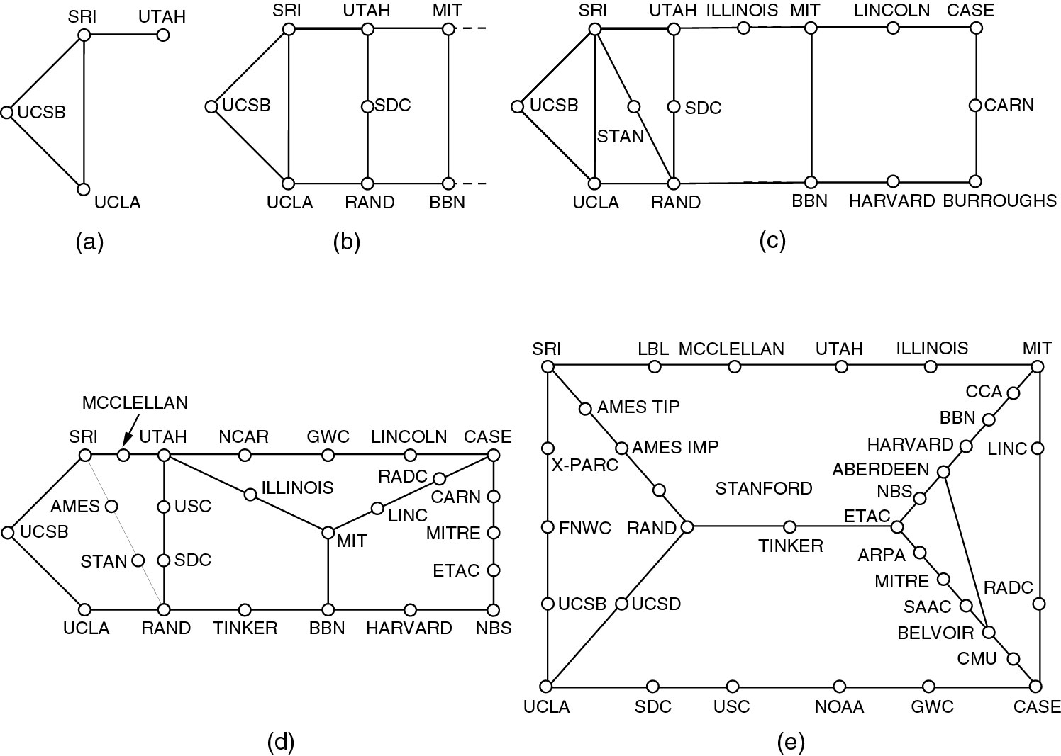
The ARPANET (3)
Growth of the ARPANET (a) December 1969. (b) July 1970.
(c) March 1971. (d) April 1972. (e) September 1972.

Slide 21
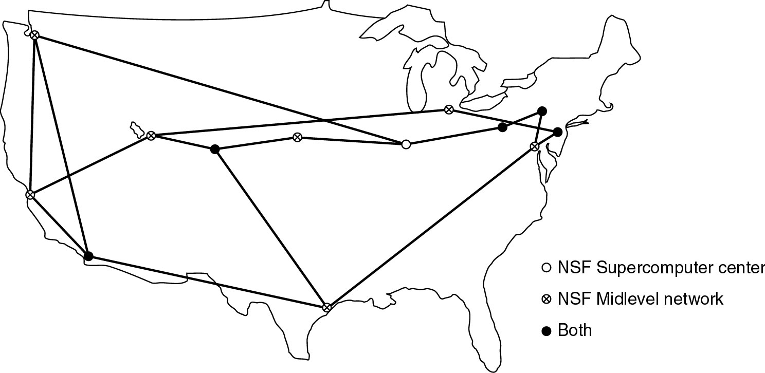
NSFNET
The NSFNET backbone in 1988.

Slide 22
Internet Usage
Traditional applications (1970 – 1990)
E-mail
News
Remote login
File transfer

Slide 23
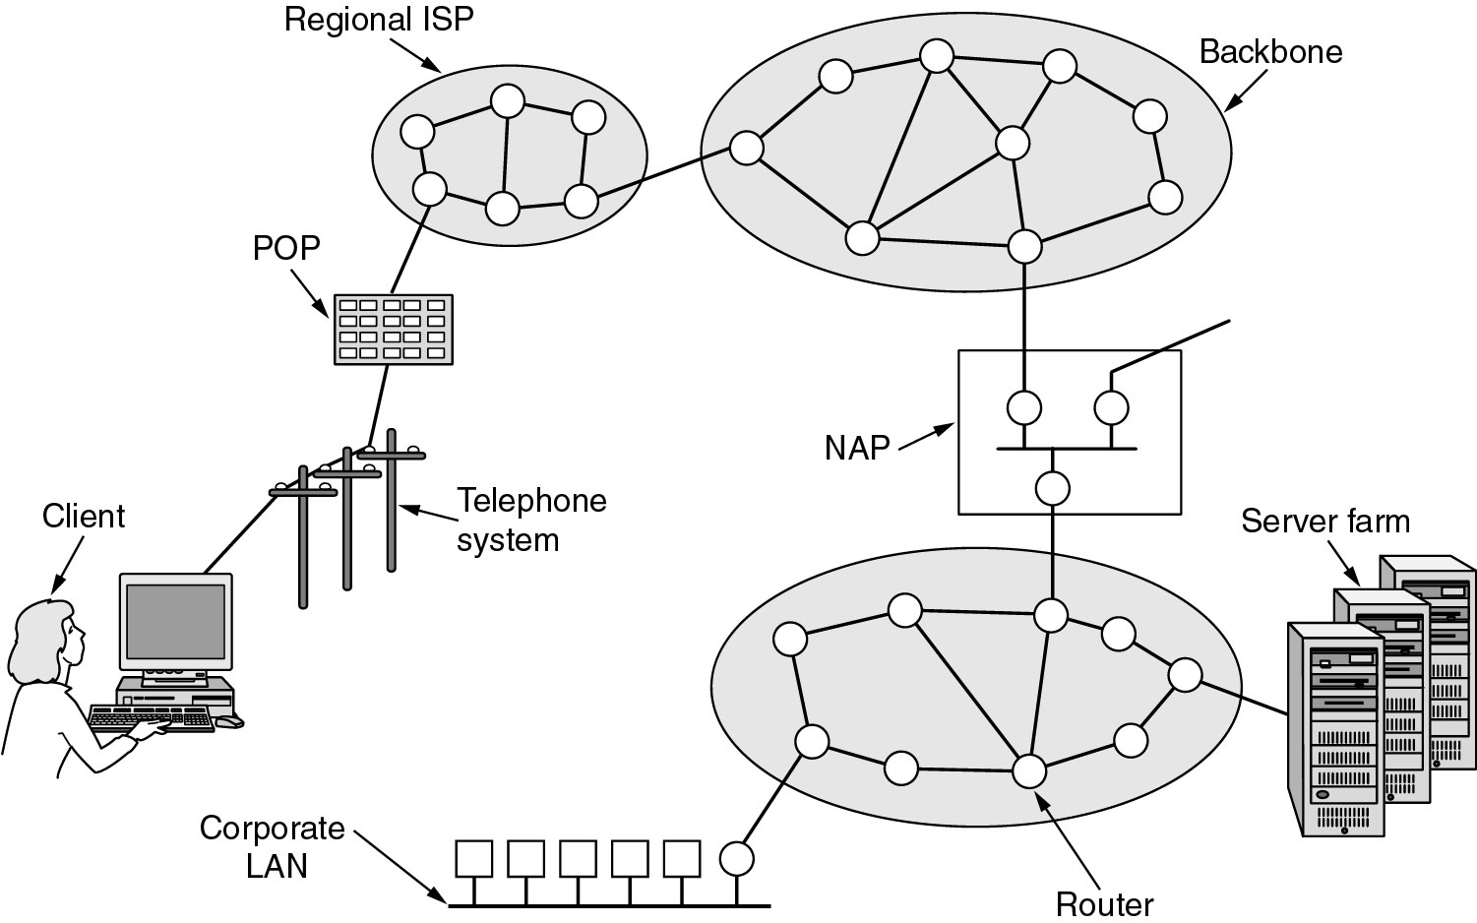
Architecture of the Internet
Overview of the Internet.

Slide 24
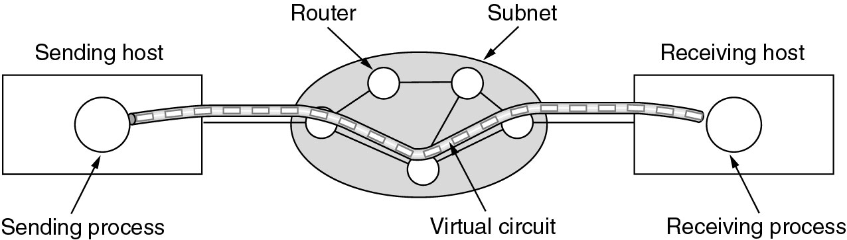
ATM Virtual Circuits
A virtual circuit.

Slide 25
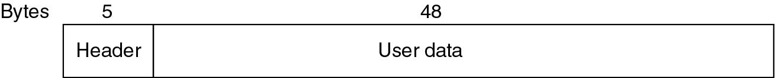
ATM Virtual Circuits (2)
An ATM cell.

Slide 26
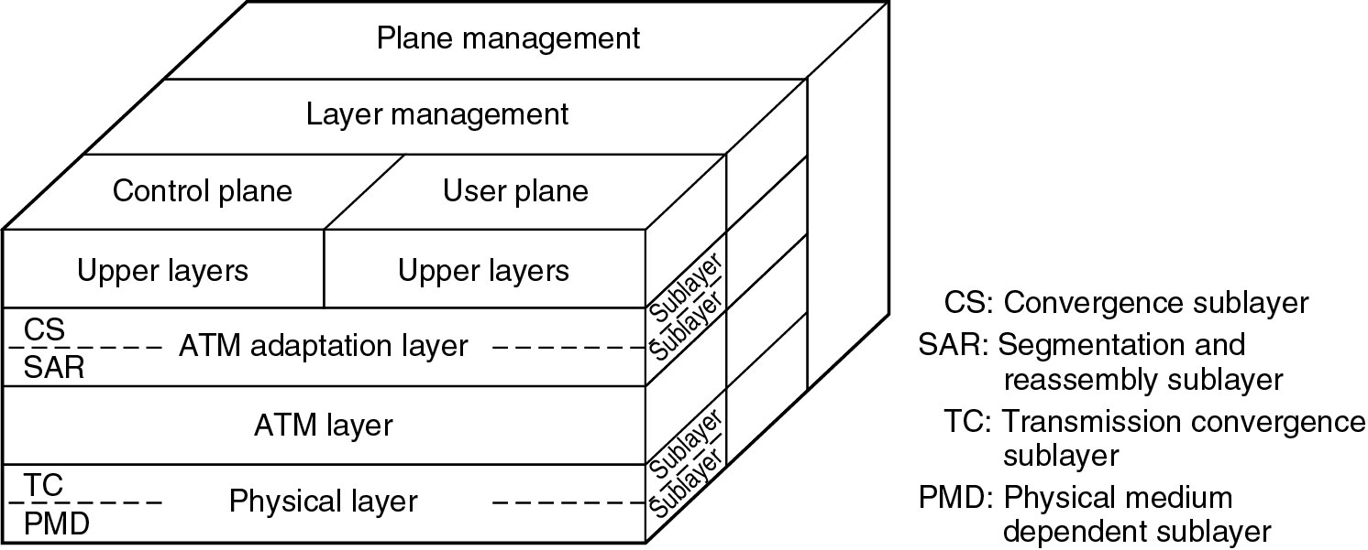
The ATM Reference Model
The ATM reference model.

Slide 27
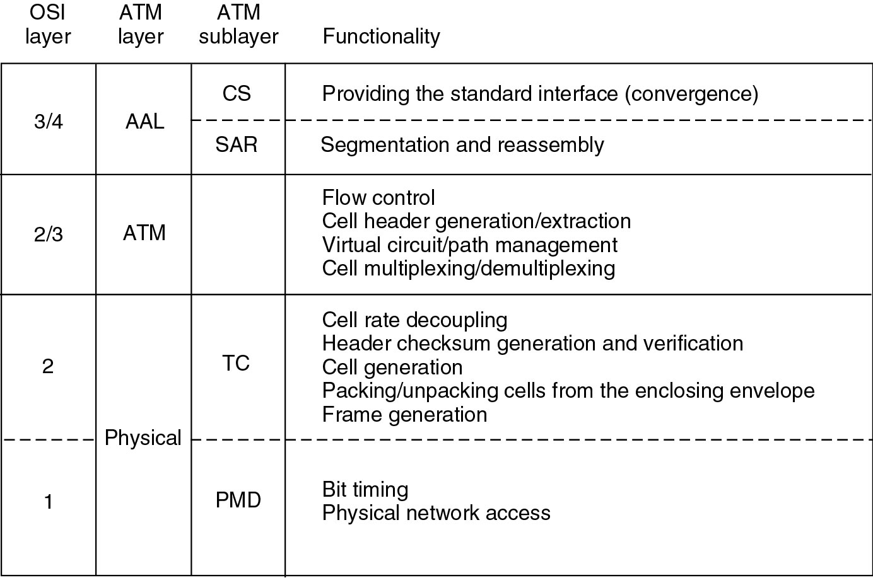
The ATM Reference Model (2)
The ATM layers and sublayers and their functions.

Slide 28
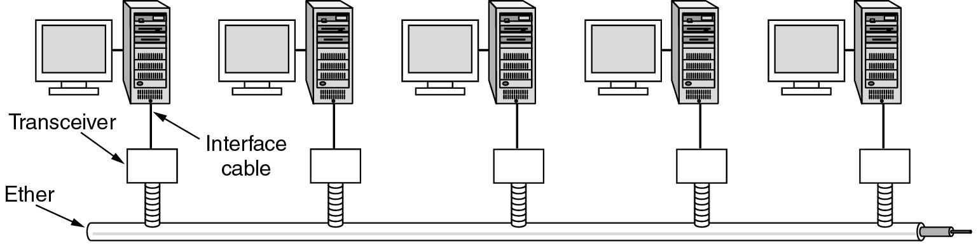
Ethernet
Architecture of the original Ethernet.

Slide 29
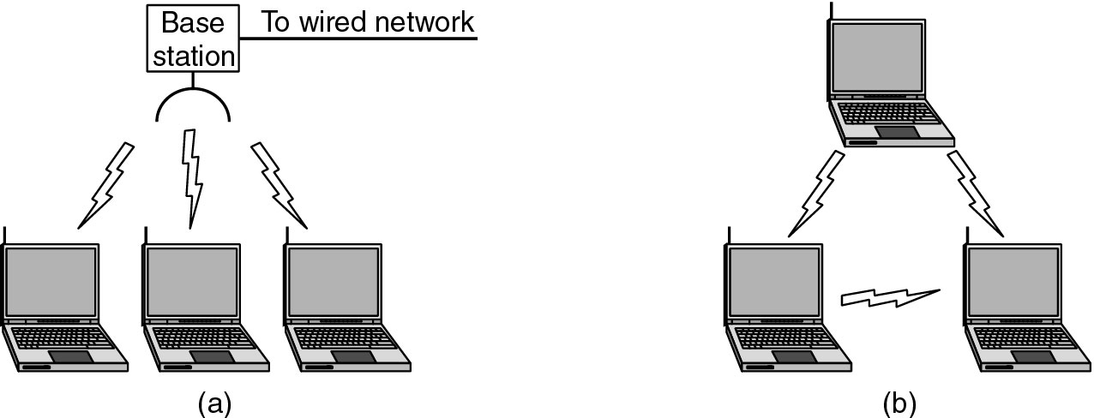
Wireless LANs
(a) Wireless networking with a base station.
(b) Ad hoc networking.

Slide 30
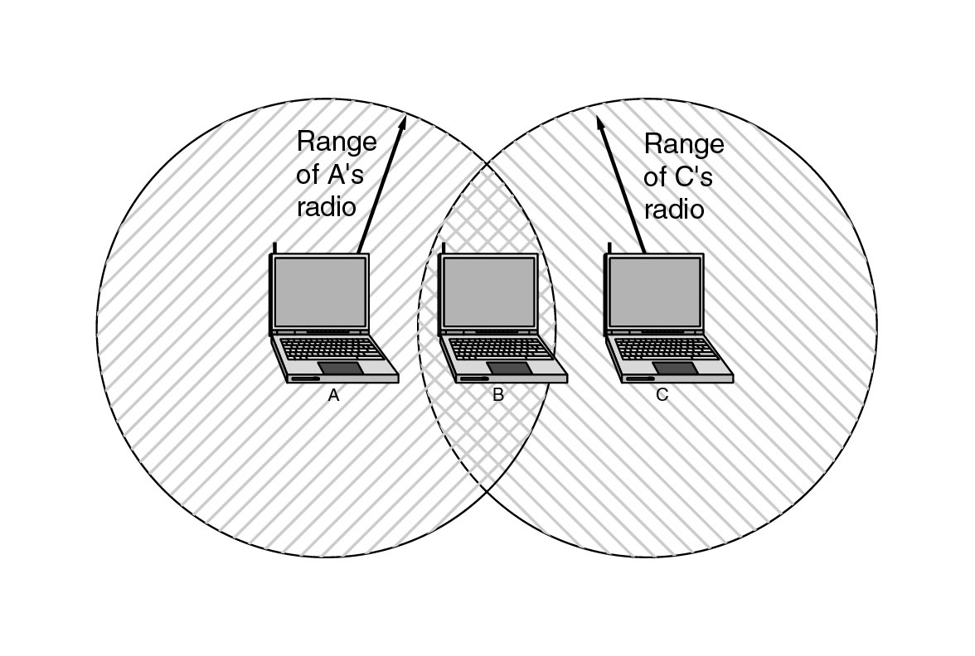
Wireless LANs (2)
The range of a single radio may not cover the entire system.

Slide 31
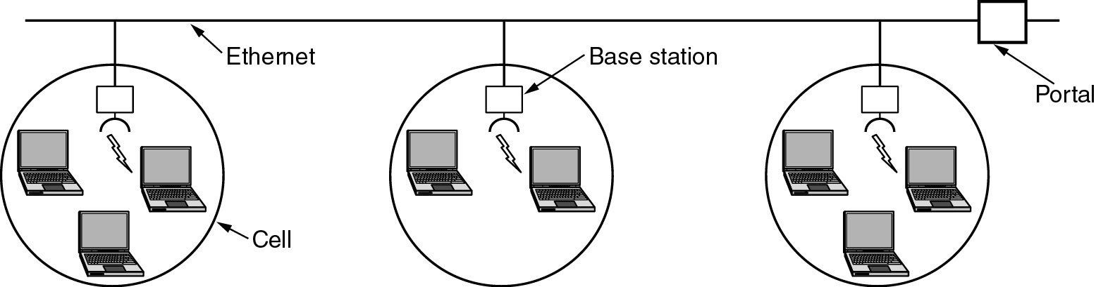
Wireless LANs (3)
A multicell 802.11 network.

Slide 32
Network Standardization
Who’s Who in the Telecommunications World
Who’s Who in the International Standards World
Who’s Who in the Internet Standards World

Slide 33
ITU
Main sectors
  Radiocommunications
  Telecommunications Standardization
  Development
Classes of Members
  National governments
  Sector members
  Associate members
  Regulatory agencies

Slide 34
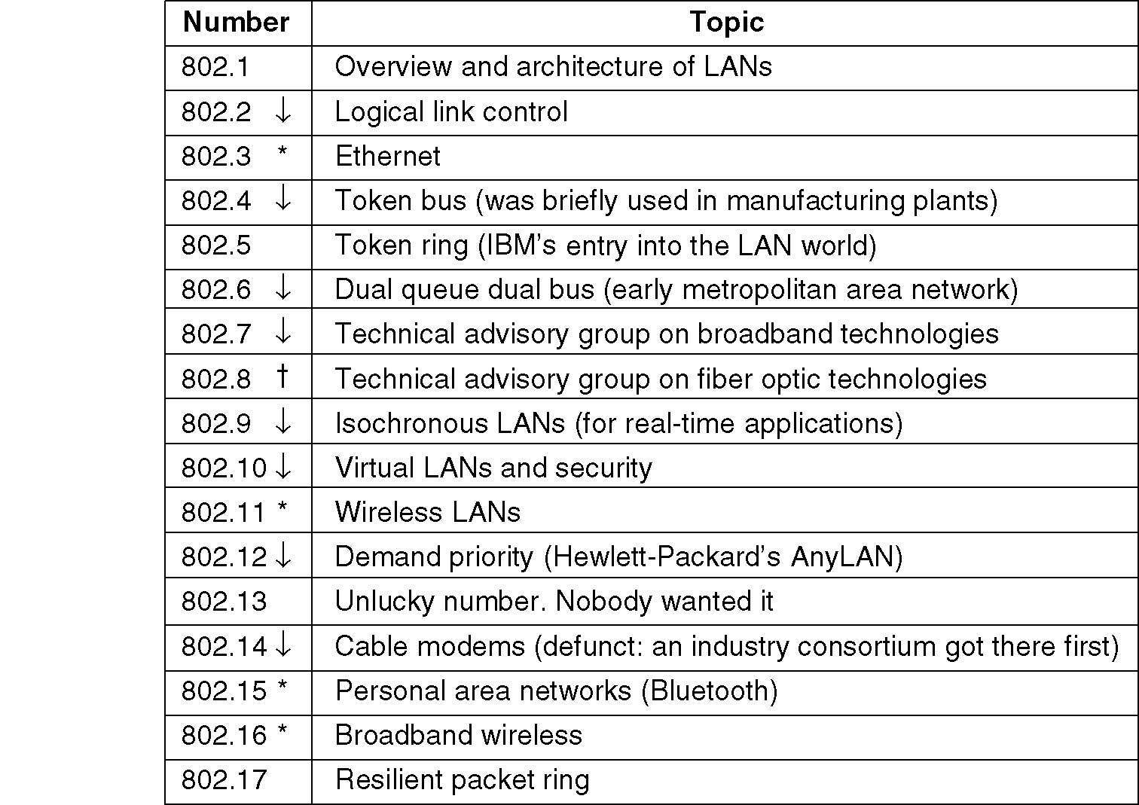
IEEE 802 Standards
The 802 working groups. The important ones are marked with *. The ones marked with ↓ are hibernating. The one marked with † gave up.

Slide 35
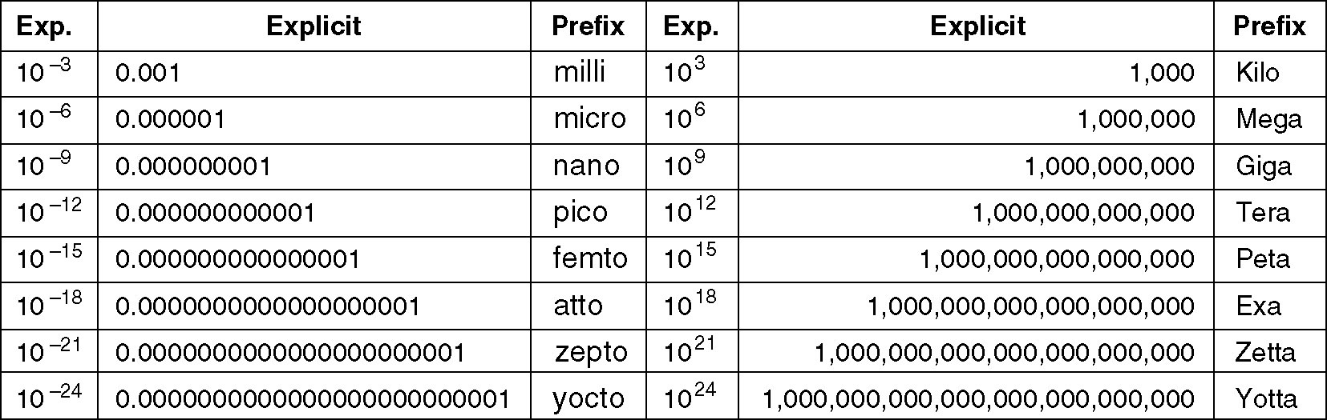
Metric Units
The principal metric prefixes.

